Slide 1
Dynamic Care Planning Diagram

Slide 2
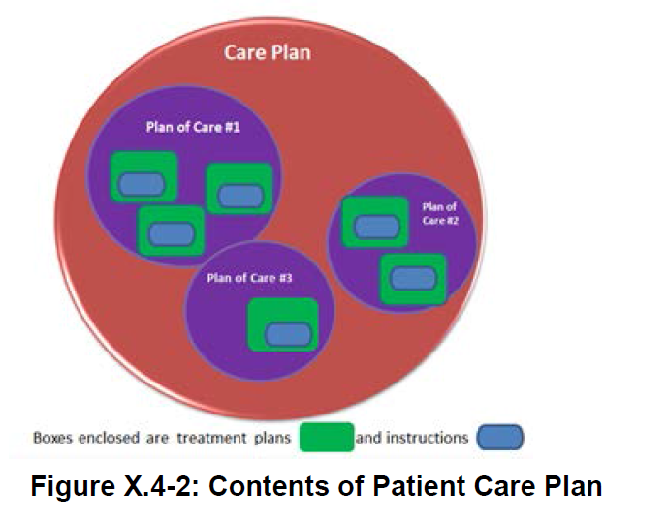

Slide 3
Dynamic Care Planning
Home and Community Services Planning
Ambulatory Care Planning
Transportation Plan
In Patient Planning
Personal Advance Care Planning
Skilled Nursing Care Planning
Allied Health Plan
Medical/Surgical Plan
Pharmacy Plan
Home Health Planning
Discipline Specific Planning
Chronic Disease Planning
Skilled Nursing Plan
OT/PT Plan
Social Work Plan
Payer Planning
Wellness/Health Promotion Planning
Disease Management Plan
Case Management Plan

